Slide 1
Rethinking Strategies for Improving Engagement and Participation in Pest Animal Management
Lynette McLeod
Don Hine
Andrew Bengsen

Slide 2
IA CRC Program 4: Facilitating effective community action
Effective community engagement practice
increase participation in coordinated actions
develop partner capacity to work with the community
Triggers for effective action
design, implement, evaluate new intervention strategies
improving communication strategies
Reducing institutional barriers to citizen action
www.invasiveanimals.com/research/phase2/community-engagement/

Slide 3
“Management is a series of continuing and related activities to achieve defined goals/objectives by working with and through people”

Slide 4
4 Key Stages For Developing Behaviour Change Strategy: Overview
Define problem in human behavioural terms
Identify factors that influence behaviour
Select appropriate intervention strategies
Implement and evaluate

Slide 5
Define the Problem in Human Behavioural Terms
Define the issue
What is the issue, why is it an issue, who is affected?
Understand the underlying behaviours
Identify specific human behaviours that contribute to the issue and that will resolve the issue, and who is involved in these behaviours
Select the target behaviour(s)
Identify the target audience
“To be effective, behavioural change needs to deal with specific behaviours and actions in a given context”

Slide 6
Identify influential factors of behaviour performance
“Changing peoples’ behaviour involves positively influencing those factors that inspire people to act and decreasing or removing those factors which impede them”
CAPABILITIES | OPPORTUNITIES | MOTIVATIONS
Awareness | Physical | Values
Know how | Economic | Beliefs
Physical skills | Technological | Attitudes
Cognitive/personal skills | Social | Personal norms
Confidence | Cultural | Emotions
 | Institutional | Social norms
 |  | Response efficacy

Slide 7
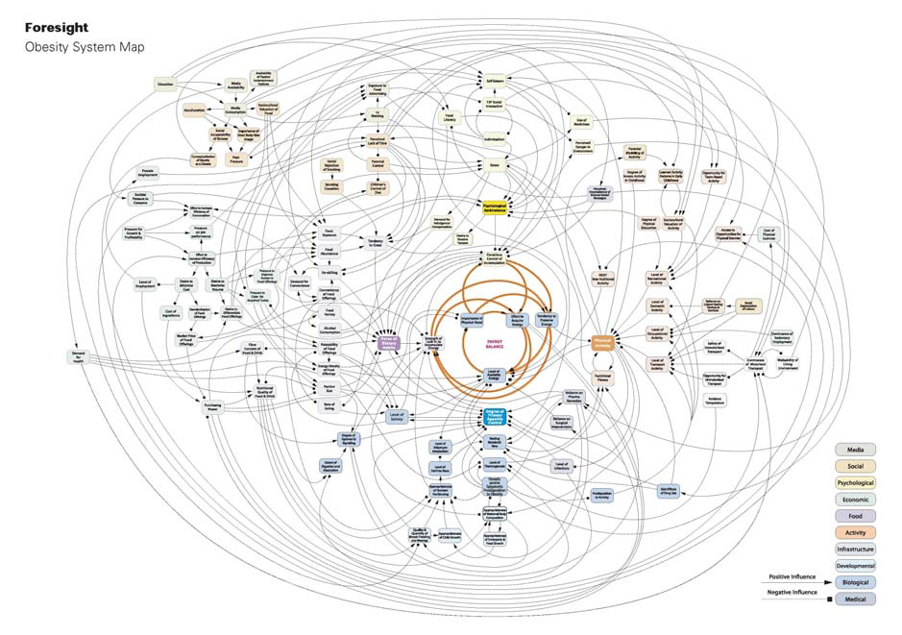
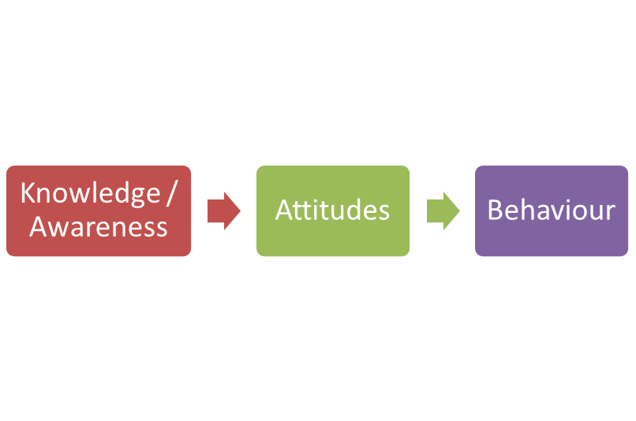
Human behaviour can be complex

Slide 8
Human decision-making
?
COGNITIVE
AUTONOMOUS
Reasoned
Intuitive
Rational
Habitual
Emotional
Cost/Benefit
Heuristics

Slide 9
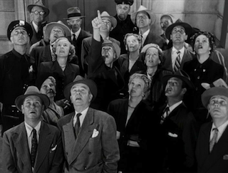
Influence of social norms
descriptive norms (what people do)
tend to be more influential than injunctive norms (what people are told they should do)

Slide 10
Human Motivation
“Different forms of motivation regulation (internalisation) influence the effectiveness and sustainability of behaviour change”
Internalisation can be best understood as a spectrum with varying degrees from external to internal regulation
External
Introjected
Identified
Integrated
Intrinsic
“Correction does much but
encouragement does more” Goethe

Slide 11
Know Your Audience
Not everyone views pest animal problems in the same way
Distinct audience segments may reflect different values, beliefs, knowledge and current behaviours
The nature of these audiences needs to be understood if engagement is to succeed, and participation improved.

Slide 12
Audience segmentation - Stages of Change
STAGE OF CHANGE | INTERVENTION GOAL
Precontemplation | Increase awareness of invasive animal issues Engage emotions to capture attention
Contemplation | Increase motivation to change Highlight costs and the benefits.
Preparation | Increase self-efficacy and confidence Reinforce beliefs that change is possible & desirable Help users plan for change
Action | Provide real-time support and advice Highlight common pitfalls and how to avoid them
Maintenance | Provide feedback on progress and constructive advice for continuous improvement Provide reminders and prompts to help ensure desired practices continue

Slide 13
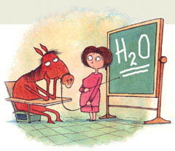
Design the intervention strategy
Select appropriate behaviour change technique that addresses the identified drivers and barrier
Select appropriate and engaging message that reaches the audience (communication strategy)
Select an appropriate mode of delivery
“Any strategy should be affordable, practical, cost-effective, acceptable, fair and have no adverse side-effects”

Slide 14
Selecting appropriate techniques: Linking behaviour change strategies to barriers/drivers
Strategies | Capabilities | Opportunities | Motivations
Persuasive communication |  |  | ✓
Education | ✓ |  | ✓
Training | ✓ | ✓ | ✓
Modelling |  | ✓ | ✓
Enablement | ✓ | ✓ | ✓
Environmental restructuring |  | ✓ | ✓
Incentivisation |  |  | ✓
Restrictions |  | ✓
Coercion |  |  | ✓

Slide 15
Behaviour change technique | Persuasion | Education | Training | Modelling | Enablement | Env. Restructure | Incentives | Restriction | Coercion
Issue/behaviour information | ✓ | ✓ | ✓ |  | ✓
Consequence information | ✓ | ✓ | ✓ |  | ✓
Threats | ✓
Framing | ✓ |  |  | ✓
Credible messenger | ✓ |  |  | ✓ |  | ✓
Debunking misinformation | ✓
Pros and cons | ✓
Goal setting | ✓
Commitment | ✓
Social comparison | ✓ |  |  | ✓ |  | ✓
Social approval | ✓ |  |  |  |  | ✓
Feedback |  | ✓ | ✓
Behaviour instruction |  | ✓ | ✓
Demonstration |  |  |  | ✓
Covert learning/self-belief |  |  | ✓ |  | ✓
Prompts/cues |  |  |  |  | ✓ | ✓
Social support | ✓ |  | ✓ |  | ✓
Improved methods |  |  |  |  | ✓
Physical restructuring |  |  |  |  | ✓ | ✓ |  | ✓
Social restructuring / rules |  |  |  |  |  | ✓ |  | ✓ | ✓
Punishment |  |  |  |  |  |  | ✓ |  | ✓
Rewards / subsidies |  |  |  |  | ✓ |  | ✓ |  | ✓
“Knowing is not enough; we must apply.
Willing is not enough; we must do” Goethe

Slide 16
Communication Strategy
Content should be easy to read, well presented and use appropriate language.
Content should tell the user ‘what they need to do next’ with clear directions to the next steps
“Selecting the right message will help ensure that your message is noticed, processed and acted upon”

Slide 17
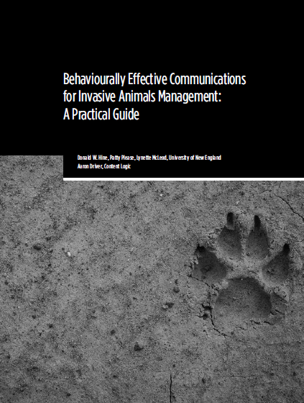
www.pestsmart.org.au/
behaviourally-effective-communications-for-invasive-animals-management/

Slide 18
Mode of Delivery
Delivery mode | Example | Best for…
Distance
Large group | Mass media (outdoor, broadcast, digital, print) | Reach large audiences Increase awareness & knowledge Create receptivity to new idea
Individual | Digital media (helpline, program or app) | Increase knowledge Provide individual assistance Improve skills and confidence
Face-to-face
Group | Peer support groups, work/school programs | Motivate with social norms Help overcome strong barriers Introduce complex actions
Individual | Home visits, opinion leaders, word of mouth | Help overcome specific barriers Provide instruction and assistance Demonstrate ease of adoption

Slide 19
Implement and evaluate
Pilot
Implement
Evaluate
the behavioural outcomes (not just outputs)
the processes used to design, develop and deliver the intervention

Slide 20
Take Home Messages
Think in human behavioural terms
Understand your target audience (don’t assume)
Use appropriate techniques for specific contexts
Target communication and delivery strategies
Evaluate both behavioural and process outcomes
“one size does NOT fit all”

